Slide 1
REAL-TIME IMPLEMENTATION OF KNN-BASED DROWSINESS DETECTION USING JETSON NANO
GROUP-10
Under The Guidance of: Dr.Goutham Makkena
2210040098-T.Sahithi Reddy 2210040116-M.Gowthami

Slide 2
COMPONENTS REQUIRED:
NVIDIA Jetson Nano Kit
Raspberry pi camera

Slide 3
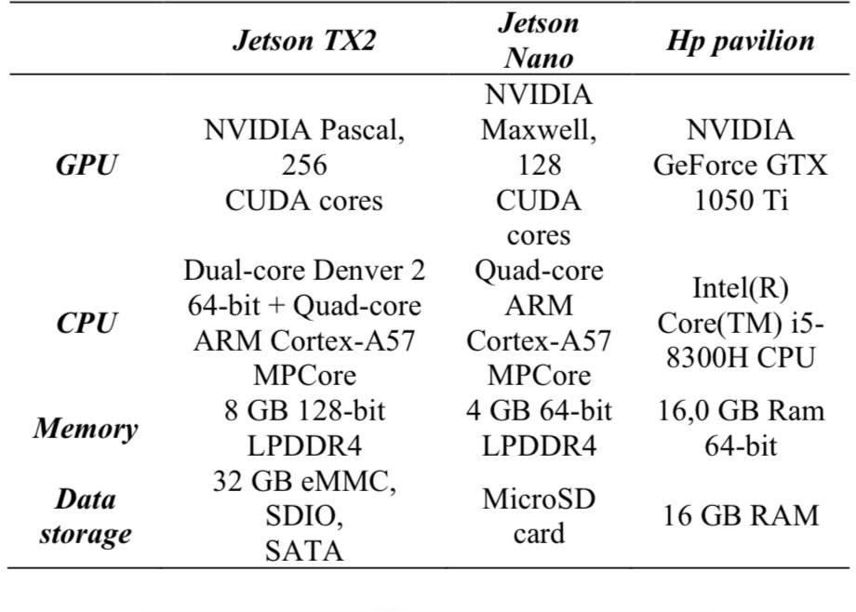
NVIDIA JETSON NANO : JETSON NANO IS A SMALL, POWERFUL COMPUTER FOR EMBEDDED APPLICATIONS AND AI IOT THAT DELIVERS THE POWER OF MODERN AI. GET STARTED FAST WITH THE COMPREHENSIVE JETPACK SDK WITH ACCELERATED LIBRARIES FOR DEEP LEARNING, COMPUTER VISION, GRAPHICS, MULTIMEDIA, AND MORE.

Slide 4
Raspberry pi camera:The Raspberry Pi camera module is a small, add-on camera designed for Raspberry Pi boards, connecting via a CSI (Camera Serial Interface) port, allowing users to capture images and record videos, and can be programmed using Python.
Key Features
CSI Interface
Image Capture and Video Recording Python Programming
AI Camera

Slide 5
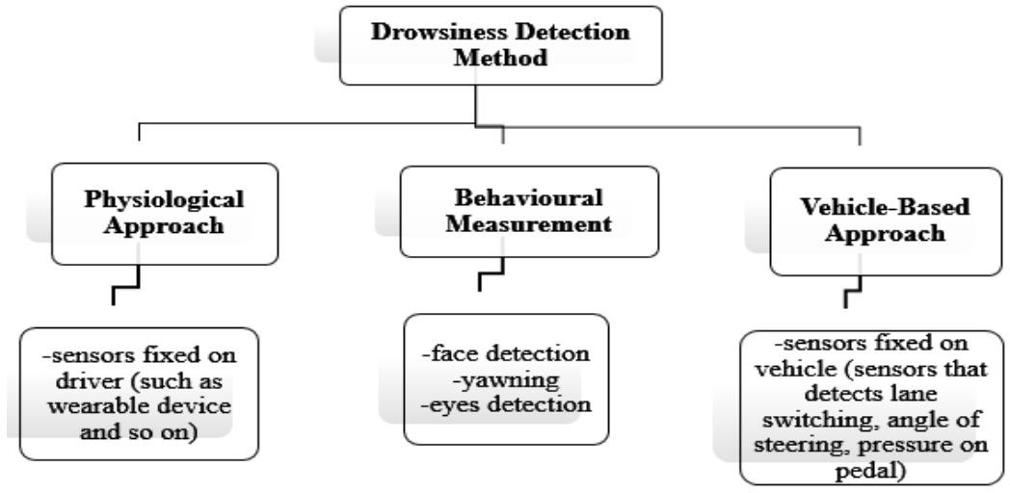
INTRODUCTION:ACCIDENTS INVOLVING VEHICLES ON ROAD ARE BECOMING UNPREVENTABLE NOWADAYS. WORLD HEALTH ORGANIZATION (WHO) ONCE HAD REVEALED THAT OVER 3400 PEOPLE DIE ON THE WORLD’S ROAD EVERY DAY AND BILLIONS OF PEOPLE ARE SUFFERING NON-FATAL INJURIES AND DISABILITIES AS A RESULT OF THEIR INJURIES . TRAFFIC SAFETY FOUNDATION STUDY FOUND THAT 37% OF DRIVERS HAVE FALLEN ASLEEP BEHIND WHEELS. THIS MIGHT BE DUE TO DROWSINESS OR MIRCOSLEEP. ACCIDENTS COULD CAUSE FATAL INJURIES AND INCREASE MORTALITY RATES.

Slide 6
WHY IT'S NEEDED:
Prevents Accidents: Drowsiness significantly impairs reaction time, judgment, and coordination, increasing the likelihood of accidents, especially while driving or operating heavy machinery.
Enhances Road Safety: For drivers, detecting drowsiness can reduce the risk of sleep-related traffic accidents, which are a major cause of fatalities worldwide.
Protects Public Health: Drowsy drivers or workers may unknowingly put others at risk, including passengers, pedestrians, and co-workers. Detection helps reduce these risks. Detects Sleep Disorders: Continuous monitoring of drowsiness can serve as an early warning sign of underlying sleep disorders, encouraging individuals to seek medical advice.

Slide 7
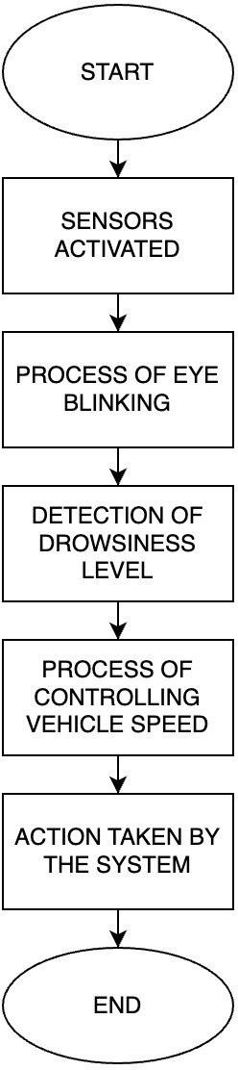
Block Diagram:

Slide 8
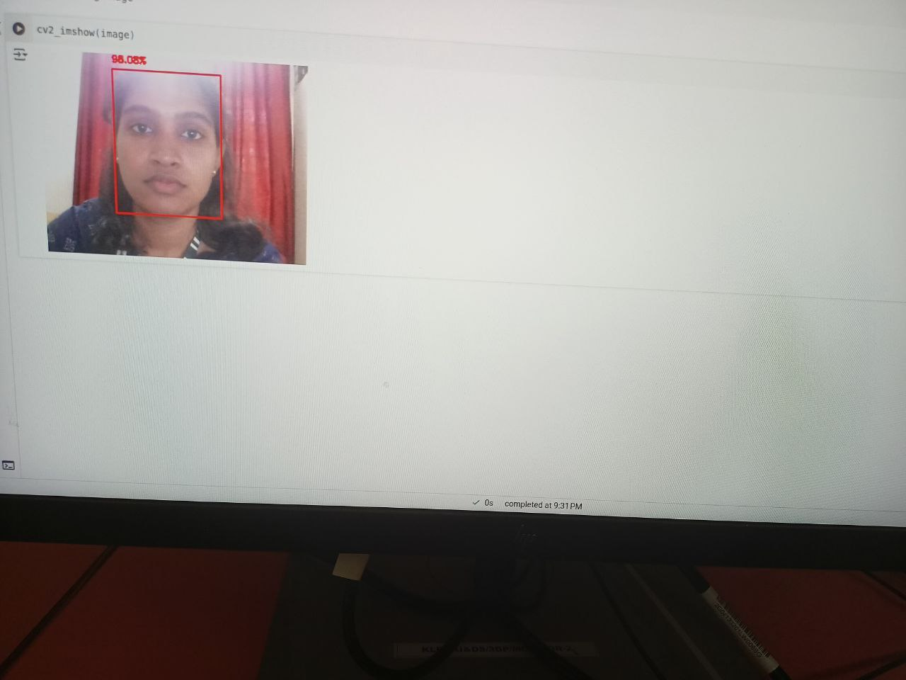
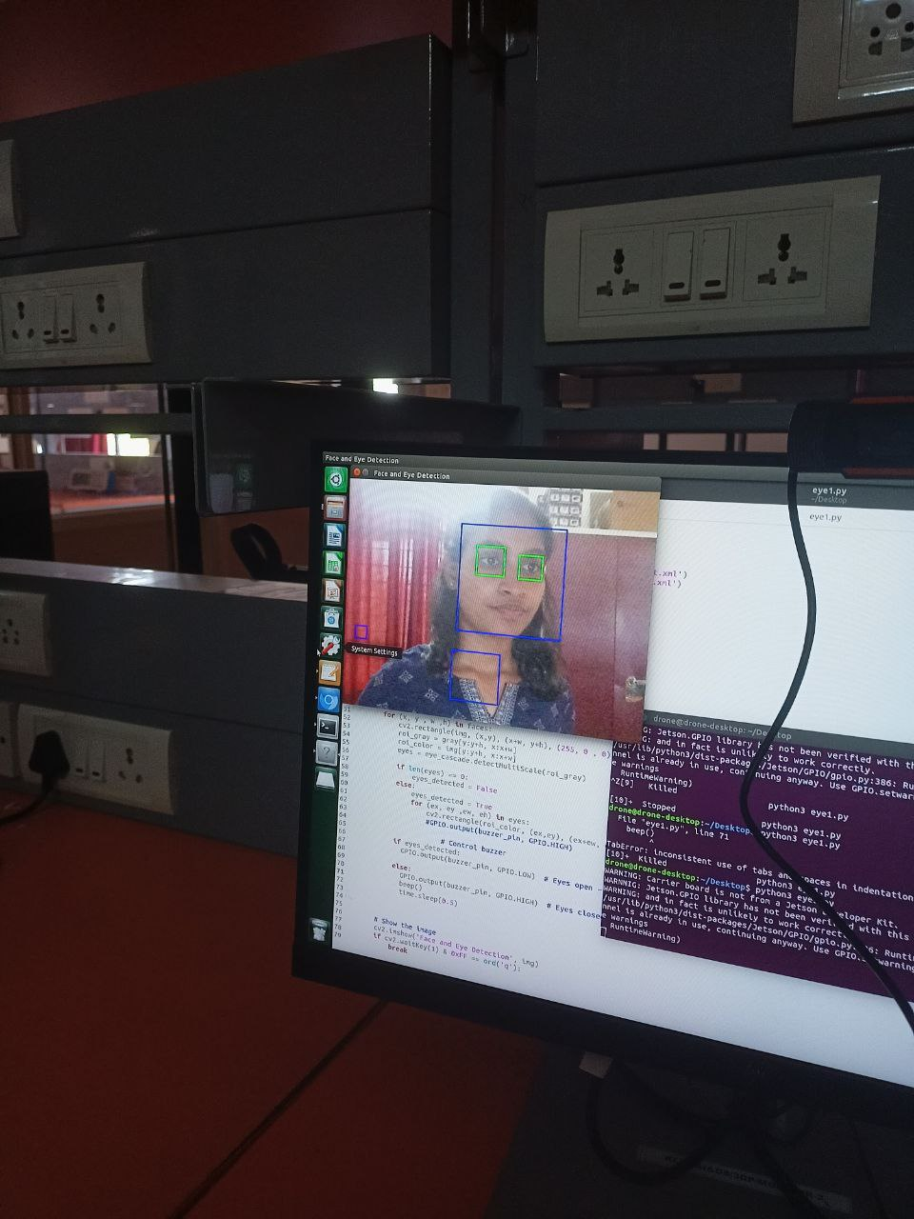
Output

Slide 9
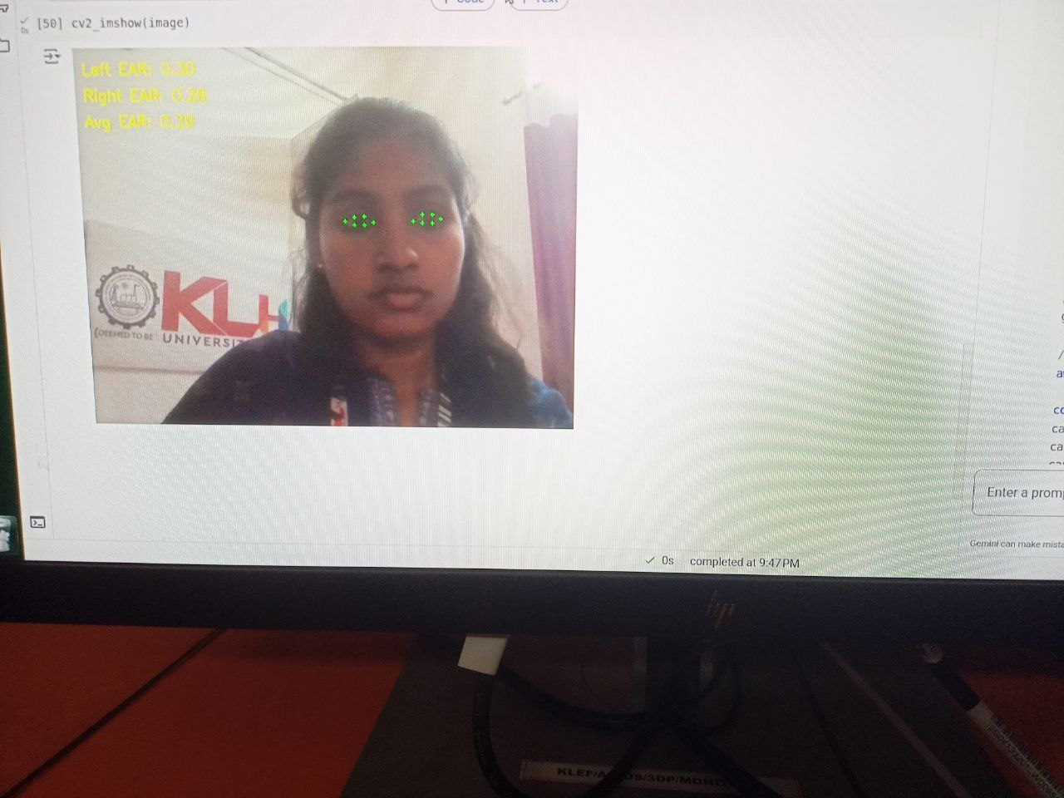
FEATURE EXTRACTION:
THE TERM "FEATURE," WHICH IS FREQUENTLY USED IN APPLICATIONS FOR IMAGE PROCESSING, MACHINE LEARNING, DEEP LEARNING, DATA MINING, AND PATTERN RECOGNITION, IS BEST DEFINED AS THE QUALITATIVE ASPECT OF AN OBJECT. DIMENSIONALITY REDUCTION CAN BE ACHIEVED THROUGH TWO APPROACHES: FEATURE SELECTION AND FEATURE EXTRACTION. WHILE FEATURE SELECTION INVOLVES CHOOSING RELEVANT FEATURES FROM THE ORIGINAL DATA, FEATURE EXTRACTION INVOLVES TRANSFORMING THE ORIGINAL DATA INTO NEW FEATURES THAT POSSESS ROBUST PATTERN RECOGNITION CAPABILITIES.
Eye Aspect Ratio :

Slide 10
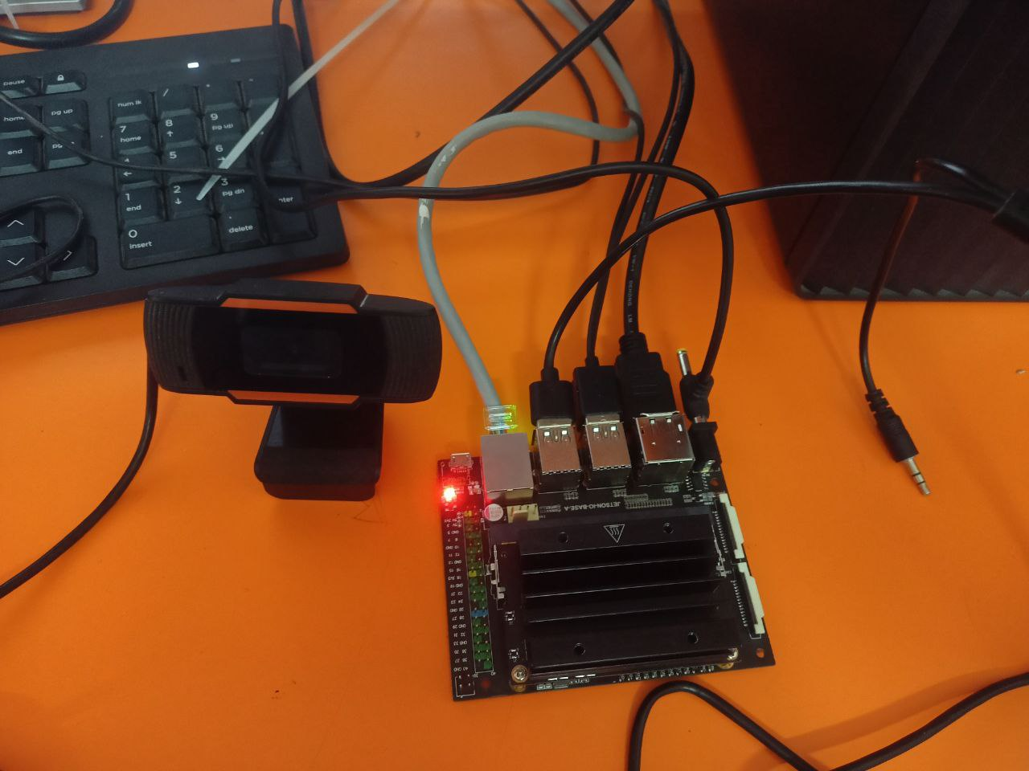

Slide 11
CONCLUSION:
Drowsiness detection is an essential tool for enhancing safety, improving productivity, and safeguarding public health. By identifying signs of fatigue early, it helps prevent accidents, especially in high-risk environments like driving and workplaces. The integration of drowsiness detection technologies not only ensures compliance with safety regulations but also contributes to long-term well-being by identifying potential sleep disorders and promoting better sleep habits. As technology continues to advance, the ability to monitor and respond to drowsiness in real-time will become increasingly efficient, ultimately leading to safer and more productive environments for individuals and communities alike.

Slide 12


